Slide 1

PERFORMANCE APPRAISALS
STAFF SENATE PRESENTATION
February 3, 2020

Slide 2

CLASSIFIED
November 2018-November 2019

Slide 3

CLASSIFIED PERFORMANCE APPRAISALS
NOV 2018 - NOV 2019
141/241 = 59%

Slide 4
CLASSIFIED PERFORMANCE APPRAISALS
DEC 2019 – PRESENT (DUE DEC 2019 / JAN 2020)
15/35 = 43%

Slide 5
UNCLASSIFIED
November 2018-November 2019

Slide 6
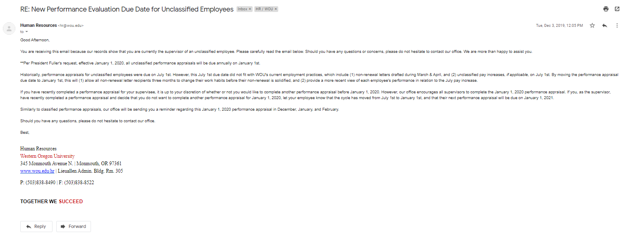
REVISED DUE DATE

Slide 7
UNCLASSIFIED PERFORMANCE APPRAISALS
NOV 2018 - NOV 2019
28/207 = 13%

Slide 8
UNCLASSIFIED PERFORMANCE APPRAISALS
DEC 2019 – PRESENT (DUE 02/07/2020)
15/207 = 7%

Slide 9

PROCESS
Month Before
Month Due
Send Email To Supervisor
Send Reminder to Supervisor
Final Reminder Regarding Performance Evaluation
Employee Receives Notification Regarding Merit Increase
Month After

Slide 10
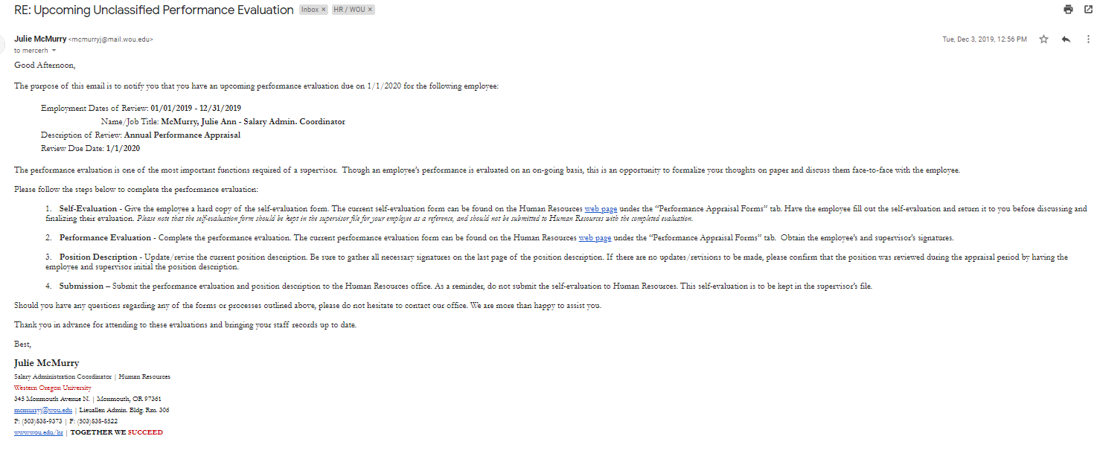
EXAMPLE EMAIL

Slide 11
QUESTIONS?
Julie McMurry
Salary Administration Coordinator
mcmurryj@wou.edu
503-838-9373
Heather Mercer
Assistant Director
mercerh@wou.edu
503-838-8963

